Slide 1
Cross Platform Feature Tracking
Building Tech-Pubs Process
Archana Pillai

Slide 2
Agenda
Support matrix for firmware
Default packaging vs. actual server support
Product Release Tracking
Voice Commands Vs. Firmware Features
Voice Features Vs. Voice Commands
Admin Support for Voice & Firmware Features
Notes:
What is the support matrix for firmware
- Subtlety of default packaging vs. actual server support
What Product Ships First and how do we do it when we are not sure which product ships first.
Voice Commands Vs. Firmware Features
-Should we show which platform supports both
Voice Features Vs. Voice Commands– should we show which platform supports both

Slide 3
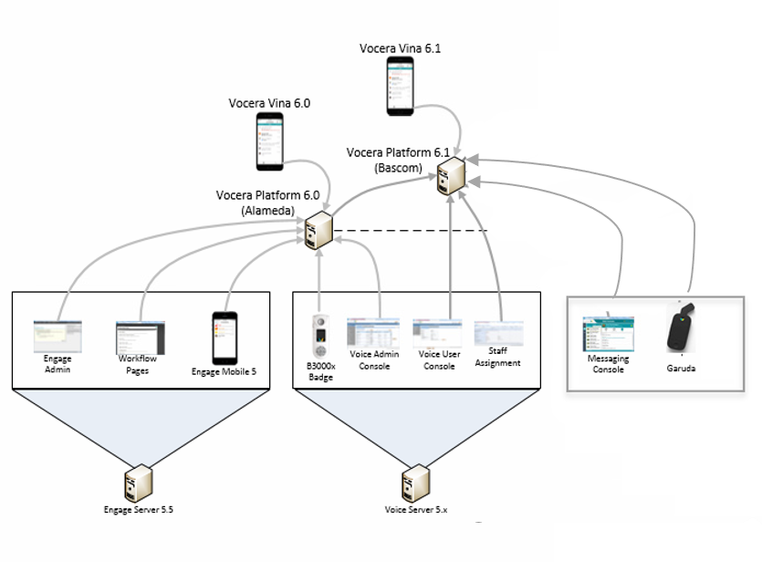
Products Supported on VS and VP
Notes:
This is an overview of what was supported in VP 6.0 and what is supported in 6.1
Notice that all (except one) Badge specific features are supported in VS (5x) first and then migrated to VP 6.1
The only exception in VP 6.1 is the V5000 Badge feature. This feature will first debut on the VP 6.1 platform before it is available on Voice Server (or 5x platform)
This is market/customer driven and is likely to happen more often
If writers continued work in silos, it will get harder to track features and support customers with documentation on all supported features

Slide 4
Both Voice and Firmware Features Need Admin Support
Some features differ by endpoints
For Example, Authentication feature on the following products:
V5000- PIN (numeric) Only
B3000n- PIN and Voice
B3000 Voice Only
Apps- PIN only
BIG QUESTION
Who will document the Admin Support information, the VS writer or the VP Writer?

Slide 5
Suggested Action Items
Create <conref> source topic for conceptual information that writers can reuse.
Platform writers document the Admin Support information in Admin Guides
Share the Feature Support Matrix across Platforms (VS &VP), Devices, and Apps.
Writers working on features that may impact devices/apps/platforms, must cross-communicate the information

Slide 6
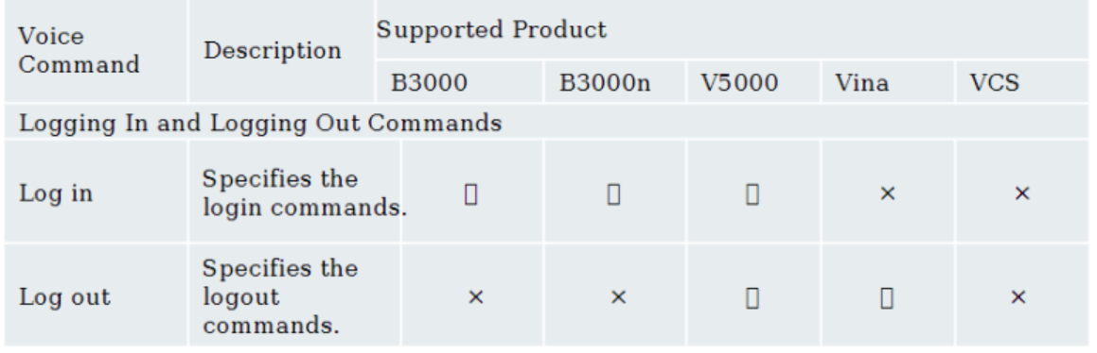
Going from here…
Notes:
So in other words, we need to change this support matrix a little bit.

Slide 7
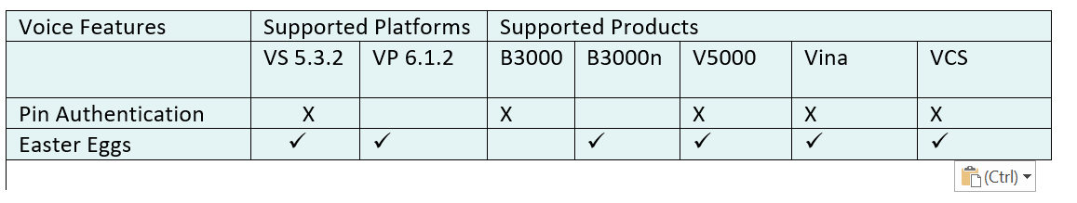
To may be here…
Notes:
May be adapt to this model where we are tracking products/features support for both supported platforms.
Here’s an example two Voice features and the support matrix for Vocera Devices and Vocera Platforms

Slide 8

Notes:
Image credit: https://www.istockphoto.com/photo/confident-doctor-at-the-reception-desk-gm589958720-101333737

